Slide 1
COLLEGE ACCOUNTING SYSTEM
Presented by:
Aaju Chandra Shrestha (01)
Abin Raj KC (02)
Aliz Acharya (04)
Dipak Pandit (11)

Slide 2
INTRODUCTION
College Accounting System is the system used to document financial transactions in college.
It can be used to keep record of employees and students.
This also can be used to calculate fees of students and salary of staffs.

Slide 3
OBJECTIVES
To provide record managing, editing, deleting and viewing facility & timely access to required records.
To keep track of all the information and simplify search of a particular record.

Slide 4
APPLICATIONS
Can be used as a primary accounting system for any college.
To keep record of all the information(financial or academic records).
Calculation of student fees.
Calculation of salary of staffs.
For billing of various activities.

Slide 5
WHY WE NEED IT?
To improve efficiency and effectiveness of accounting and billing in the colleges.
Reduce errors from manual process.
To keep track of information in effective way.
To improve service through greater access to accurate information in short period of time.
To store information in safer manner.

Slide 6
Software Development Life Cycle
It is step by step stages used for development and maintenance of a system.
Processes involved in SDLC are:
Planning
Analysis
Design
Implementation
Maintenance

Slide 7
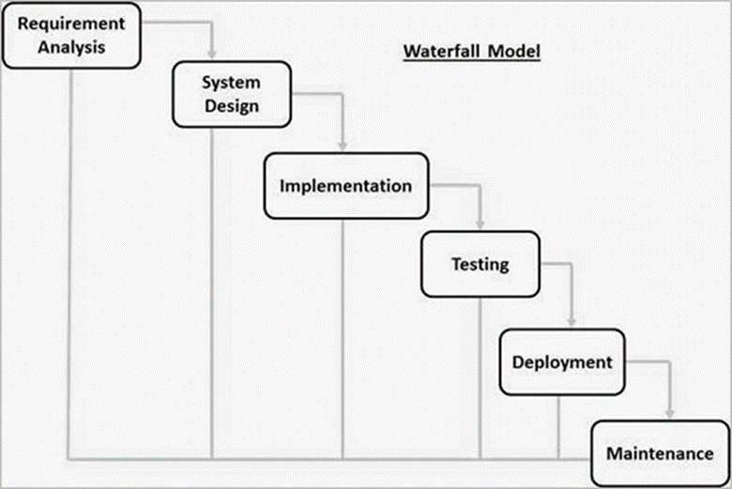
Model used: Waterfall Model
This model illustrates the software development in linear sequential flow.
The outcome of one phase acts as input for next phase sequentially.

Slide 8
Reasons behind selection
The project is short.
Easy to arrange tasks.
Requirements are very well documented, clear and fixed.
Clearly defined stages.
Product definition is stable.
Technology is understood and is not dynamic.

Slide 9
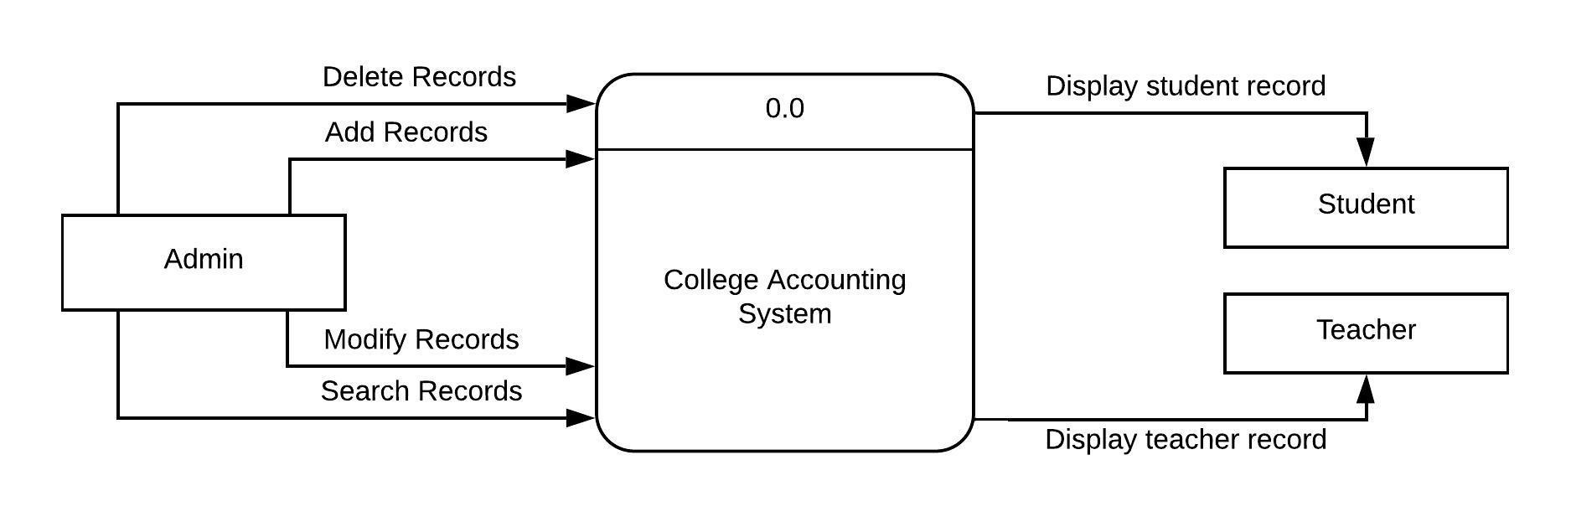
Context Diagram
It defines the scope and boundary for the system and its environment showing the entities it react with.
Context diagram for College Accounting System:

Slide 10
Data Flow Diagram
It is the way of representing a flow of a data of a process or a system (usually an information system).
Leveling of DFD:
Level 0 DFD Diagram
Level 1 DFD Diagram
Level 2 DFD Diagram

Slide 11
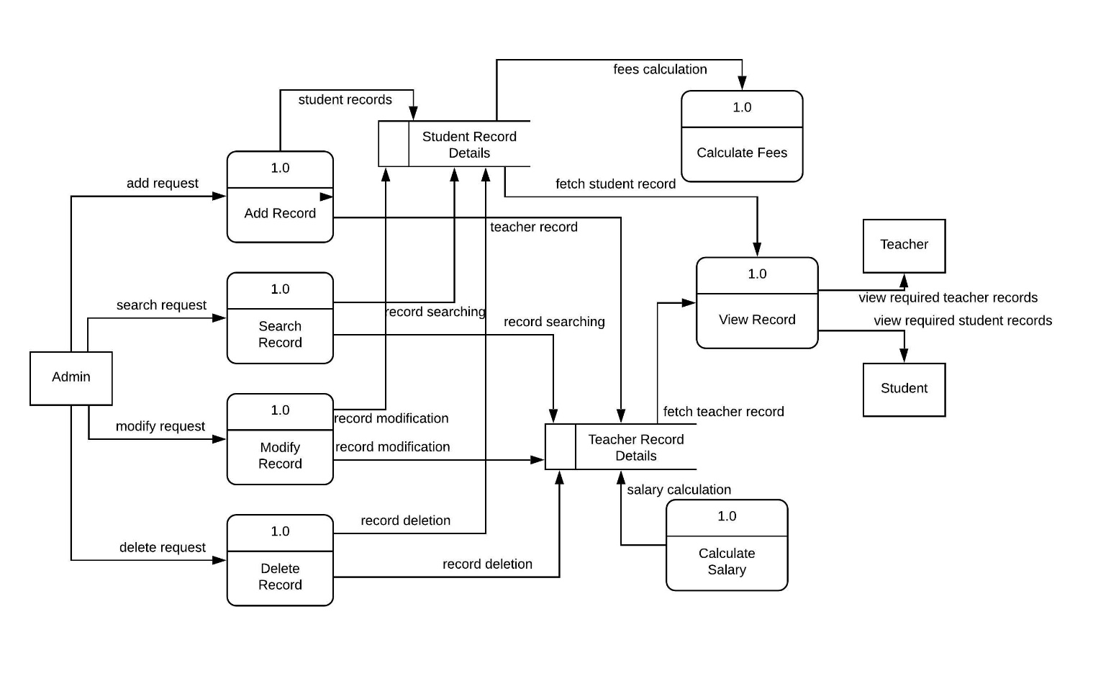
Level 0 diagram of College Accounting System:

Slide 12
ER Model
It is a graphical representation of entities and their relationships to each other.
It is expressed in terms of entities and their attributes or characteristics.

Slide 13
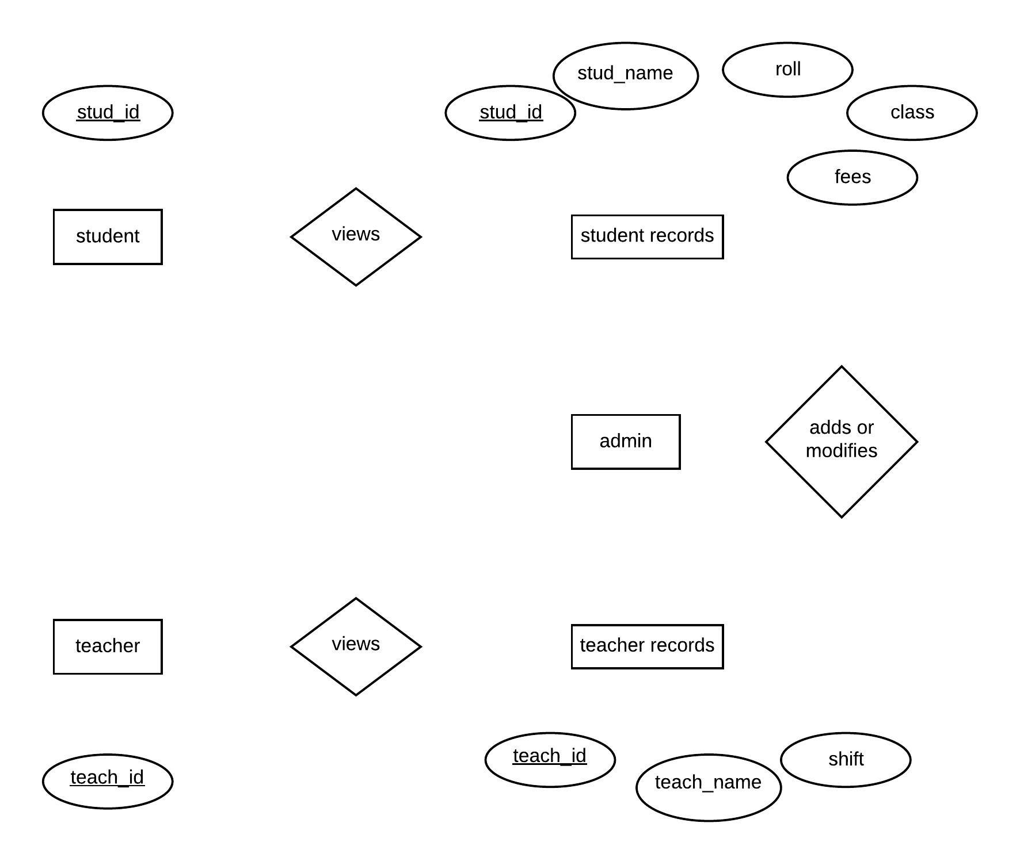
ER Model of College Accounting System:

Slide 14
Use Case Diagram
It is a representation of a user's interaction with the system.
It shows the relationship between the user and the different use cases in which the user is involved.

Slide 15
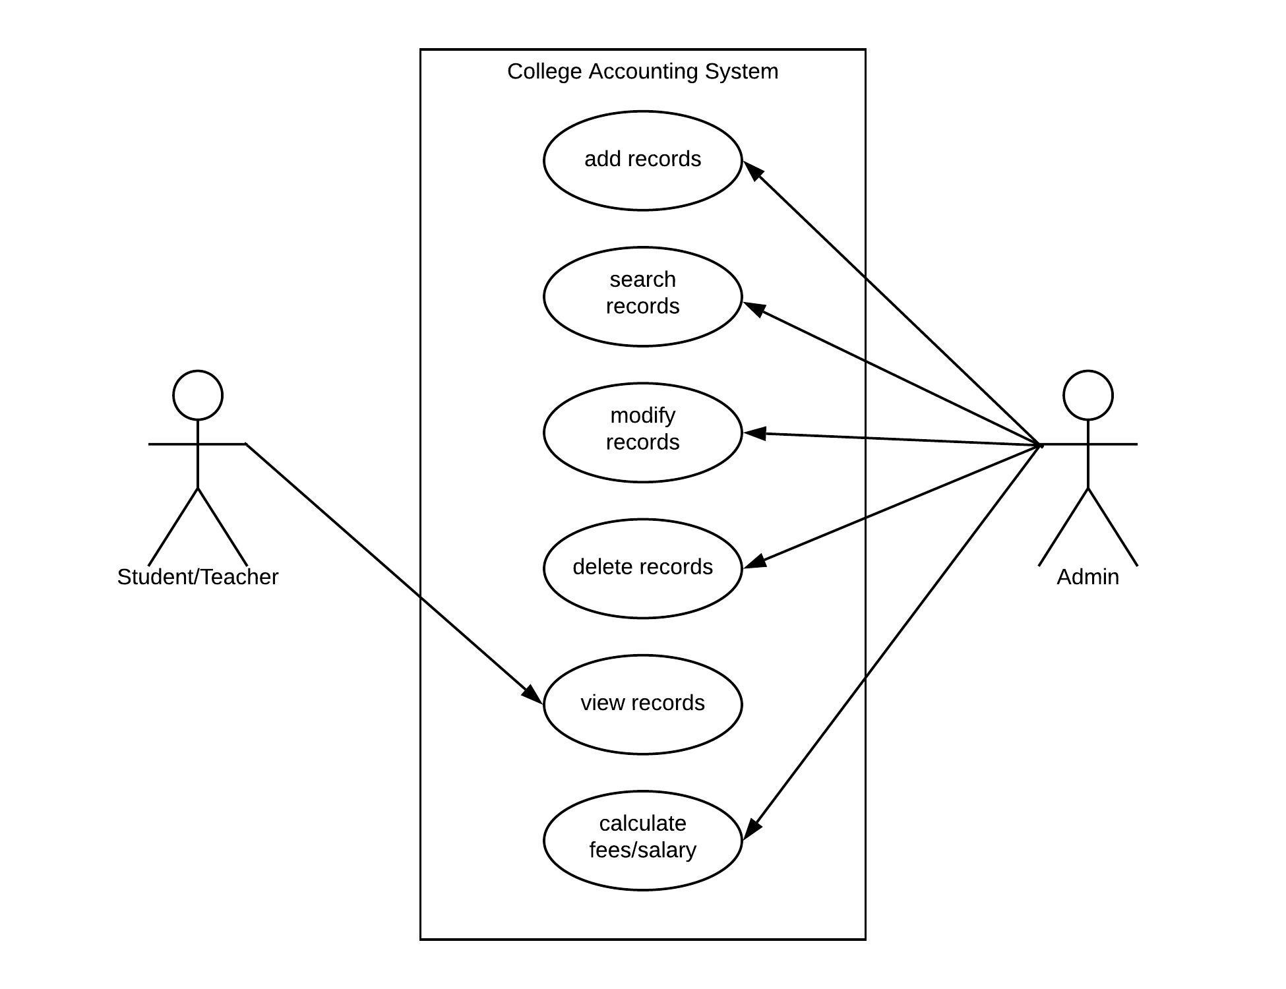
Use Case Diagram for College Accounting System:

Slide 16
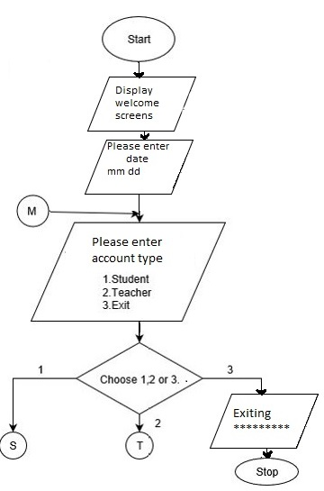
Flowchart : Of main body:

Slide 17
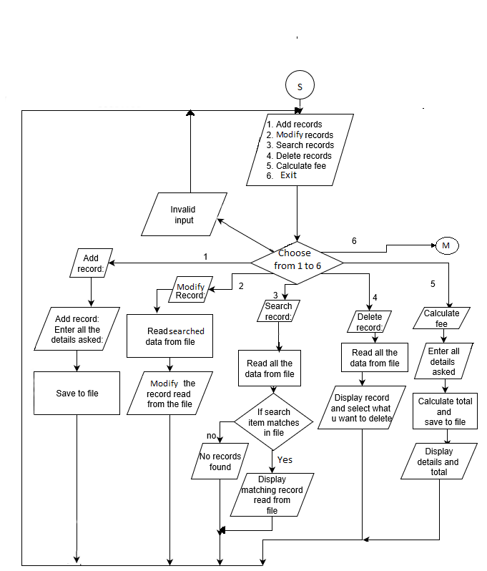
Account - Student :

Slide 18
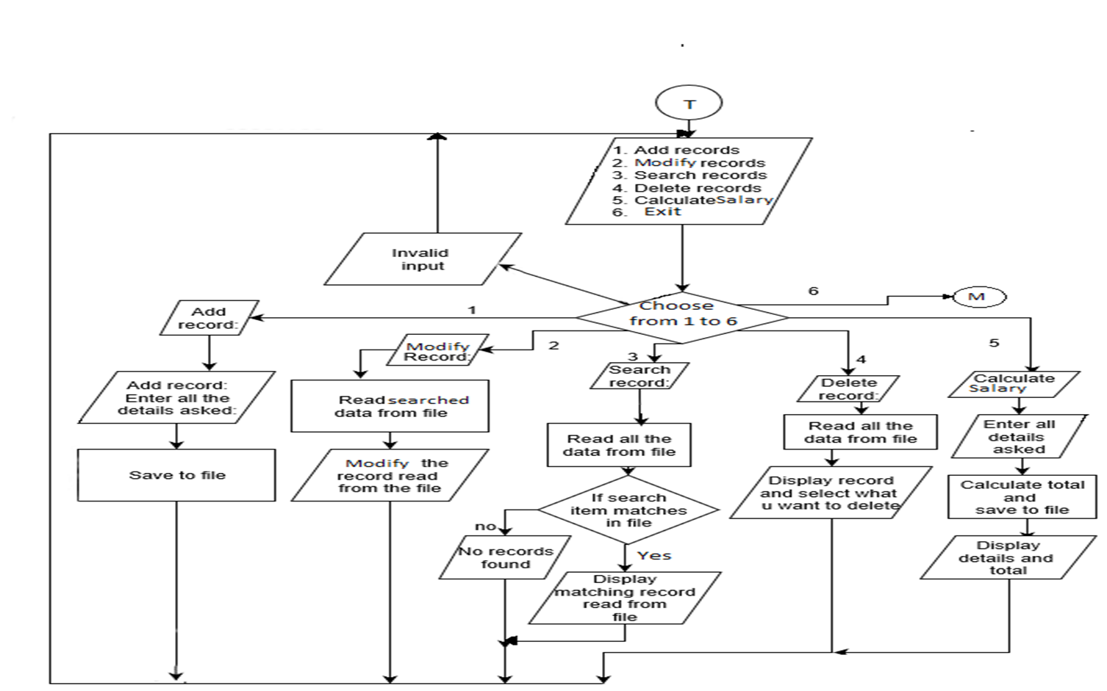
Account - Teacher:

Slide 19
FUTURE PLANS
Improve the user interface.
Add the feature of cloud hosted accounting.
Improve security through different means (fingerprint, ID cards)

Slide 20
CONCLUSION
A system will be developed which will be capable of adding, viewing, searching, modifying or deleting the required records.
It will also be capable of calculating fees and salary and save them in a file.
The system shall be available for different user profile.
The system shall be password protected for different user levels.

Slide 21
REFERENCES
https://www.Draw.io/flowchart
https://impact.zewo.ch/en/impact/step1_define_objectives/project_objective
https://www.scribd.com/document/332746808/Introduction-Mini-Project
https://www.sciencebuddies.org/science-fair-projects/science-fair/sample-conclusions
https://en.wikipedia.org/wiki/Data_flow_diagram
https://www.tutorialspoint.com/sdlc/sdlc_waterfall_model.htm
https://www.guru99.com/software-development-life-cycle-tutorial.html

Slide 22
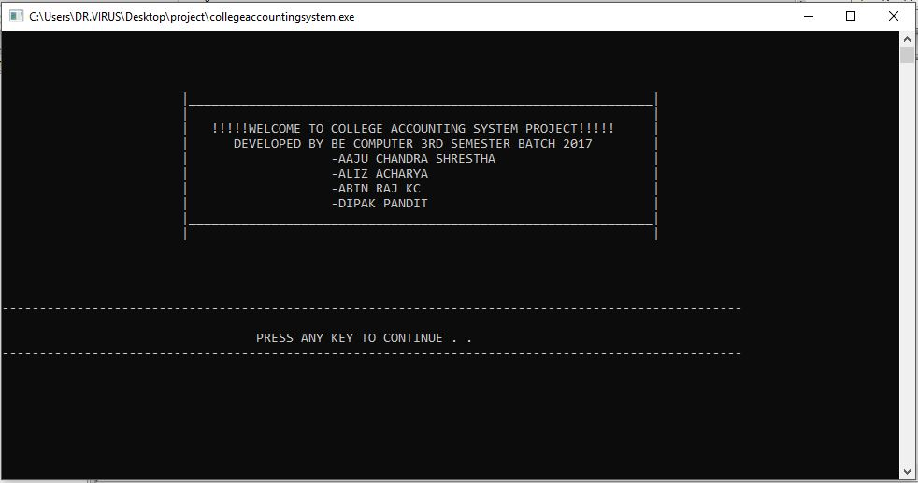
SNAPSHOTS:
FIG: WELCOME SCREEN

Slide 23
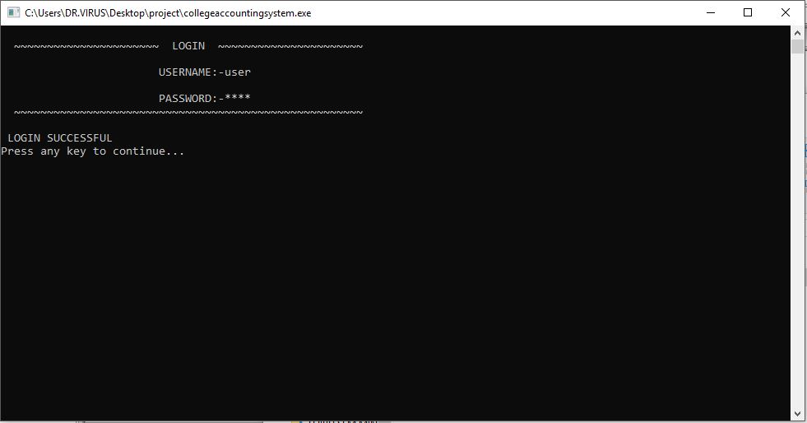
FIG: LOGIN SCREEN

Slide 24
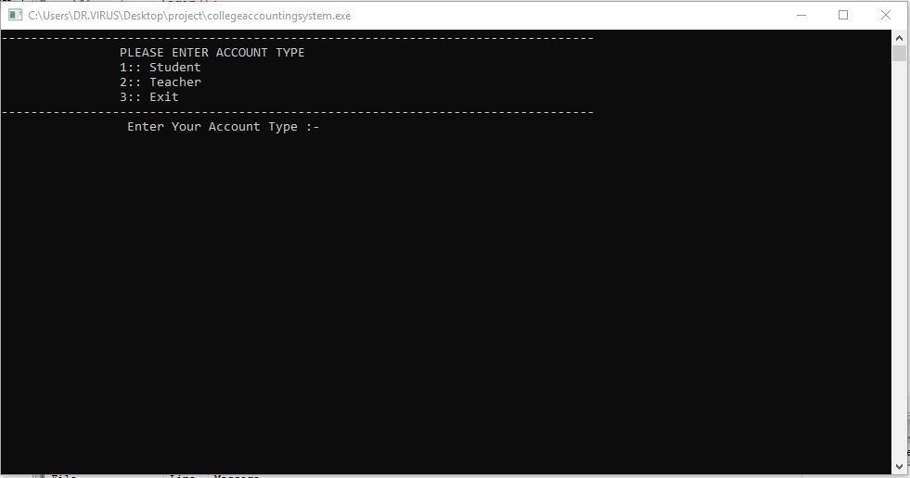
FIG: ACCOUNT TYPE SELECTION

Slide 25
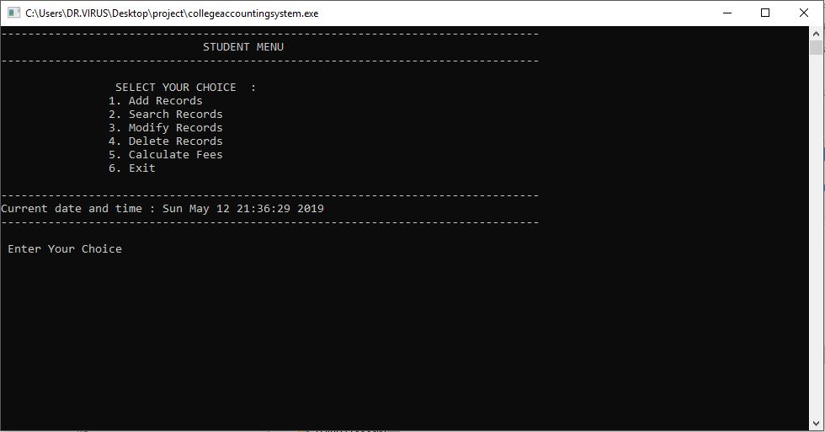
FIG: STUDENT ACCOUNT MENU

Slide 26
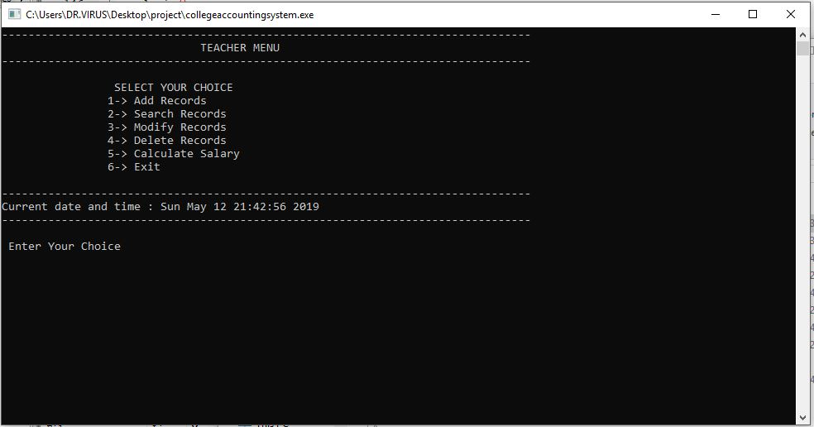
FIG: TEACHER ACCOUNT MENU

Slide 27
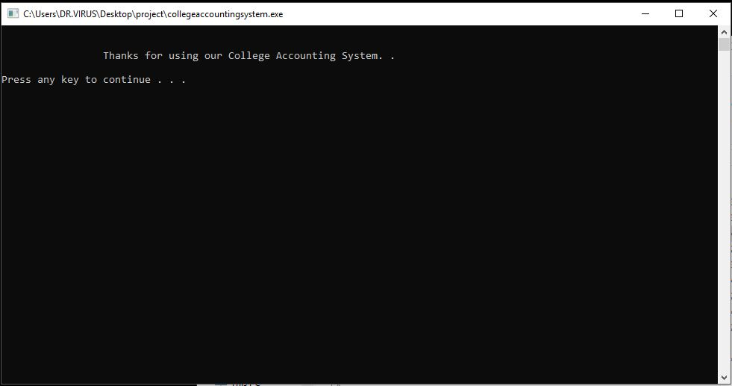
FIG: EXIT SCREEN

